Slide 1
Mitigating the Next Wave: A Comprehensive Analysis of Global COVID-19 Policies for Caladan
Team 11: Riya P, George J, Jaden H, Tracy C, Xiang F, Hannah C

Slide 2
TABLE OF CONTENTS
01
02
03
04
05
INTRODUCTION
RECOMMENDATION
POLICIES
ANALYTICS
…

Slide 3
01
INTRODUCTION

Slide 4

ANALYTICS ADVISORY BOARD
Riya Parikh Role: Team Lead, Data Analyst
Hannah Choe Role: Project Manager, Data Analyst
George Jiang Role: Data Engineer
Xiang Fu Role: Data Engineer
Tracy Cui Role: Data Analyst
Jaden Hsiao Role: Data Analyst

Slide 5
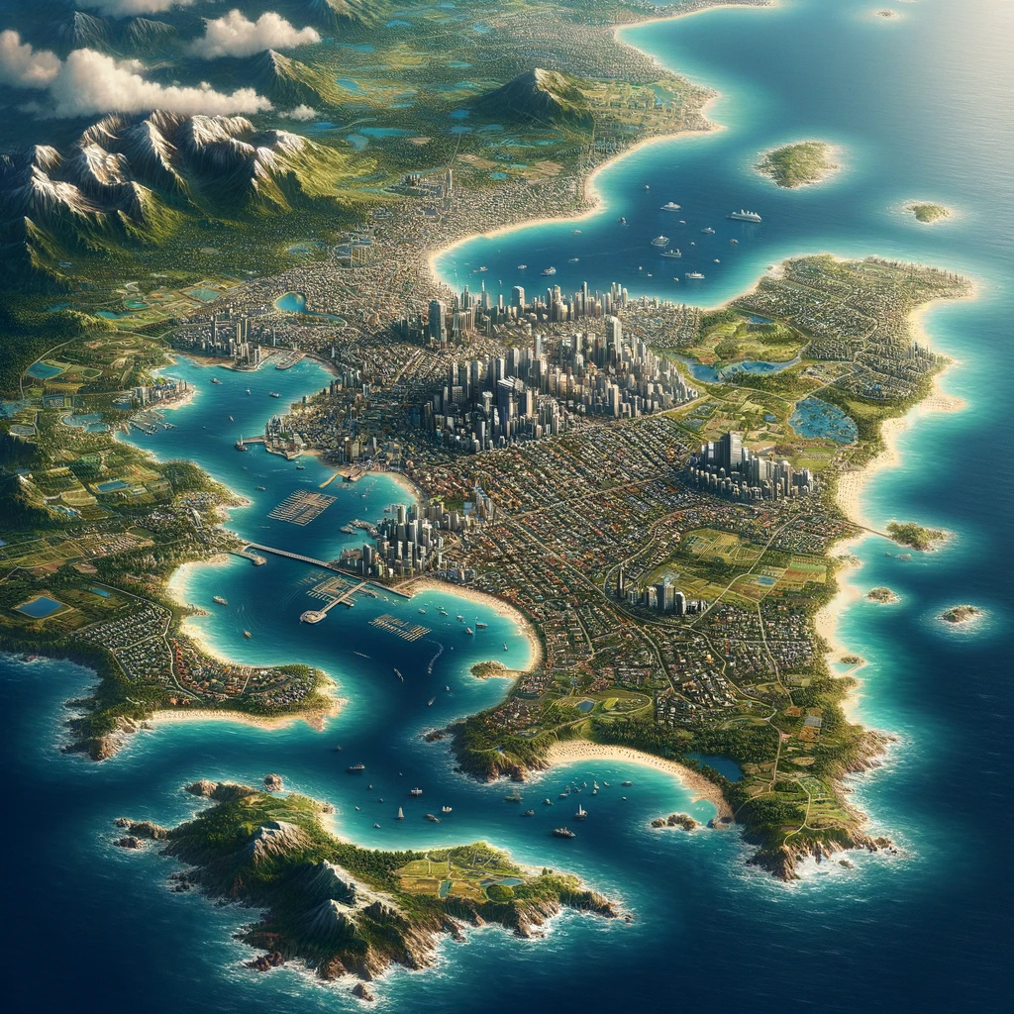
CALADAN
Population
3.2 Million
Cities
Duncan and Stillgard
Leader
President Seferlis
Key Feature
Surrounded by the Atlantic Ocean

Slide 6
02
RECOMMENDATION

Slide 7
RESULTS AND CONCLUSIONS
FUTURE STEPS
Consult policymakers with findings for immediate implementations Investigate most effective ways to educate citizens about spread of COVID and best curbing practices Implement big data architectures to monitor Caldan’s COVID response
IMPACT
Keeping the Commonwealth of Caldan safe and healthy
Implement testing policy – especially in denser cities
1
Open transportation as seen through local public transportation trends
2

Slide 8
03
POLICIES

Slide 9
POLICIES
Close Public Transportation
Testing Policy
0 - no testing policy
1 - have symptoms and meets criteria
2 - testing of anyone showing Covid-19 symptoms
3 - open public testing
0 - no measures
1 - recommend closing
2 - require closing

Slide 10
04
ANALYTICS with PowerBI Dashboards

Slide 11
05
ONE MORE THING…

Slide 12

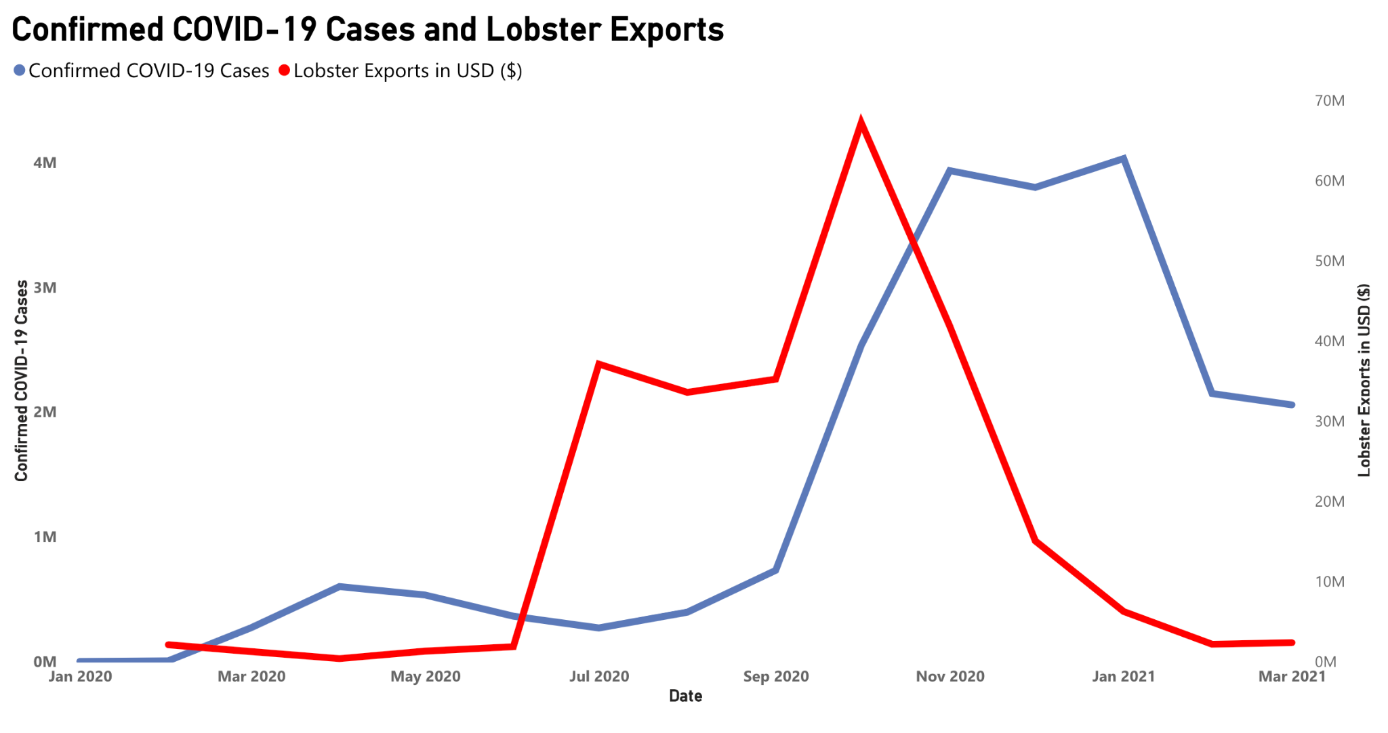

Slide 13
THANKS
DO YOU HAVE ANY QUESTIONS?

